Slide 1



Data Mining Assignment
Predicting Kitchenware Product Category from Price,
Rating, and Popularity: A Comparative Study of K-
Nearest Neighbors and Naive Bayes in Orange
Smitashree Das | PRN -25060242136

Slide 2

1.Introduction
EKitchenware is one of the diverse categories on e-commerce platforms such as Amazon, with products ranging from cookware and utensils to storage products, cleaning supplies, and appliances. These products are offered by a large number of brands and differ considerably in terms of price and popularity. This study investigates whether the broad category of a kitchenware product can be predicted using its price, star rating, review count, and brand, without relying on the product title or description. The study uses 262 real Amazon kitchenware listings from approximately 192 brands and applies two classification techniques, K-Nearest Neighbors (KNN) and Naive Bayes, to examine the predictive ability of these product attributes.

Slide 3
  Classify kitchenware products into five broad categories using price, rating, review count and brand.
  Develop a KNN model to predict product categories based on similarity between products.
  Compare KNN and Naive Bayes using accuracy, precision, recall, AUC and confusion matrix.
  Analyse business patterns in pricing, ratings and model performance across different types of brands.
2.Objectives

Slide 4

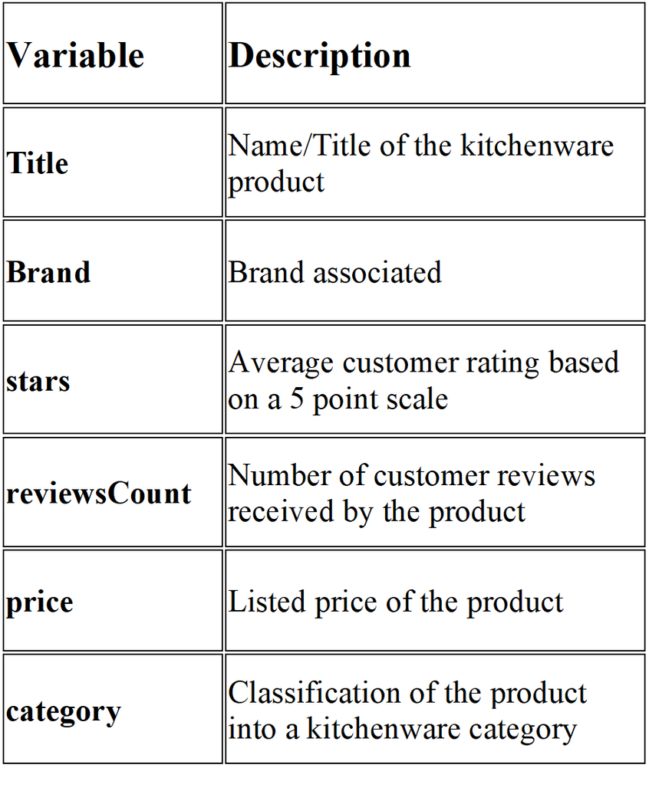
3.Dataset Description
The dataset contains information on 262 kitchenware products collected for analysing product characteristics and customer response. It has 6 variables: product title, brand, customer rating, number of reviews, price and product category.
Category Distribution
The products are classified into 5 categories :
Utensils & Gadgets — 101
Storage & Organization — 61
Cleaning Supplies — 47
Appliances — 30
Cookware — 23
Pre Processing steps:
Missing prices (3 rows) imputed using the median price of the product’s own category. description dropped (180 of 262 values missing; not used as a feature).
Brand simplification: of 192 unique brands, 156 appeared only once.
The top 15 most frequent brands were kept individually; all others grouped into "Other" .
Final modeling table: title (meta), brand (categorical), stars (numeric), reviewsCount (numeric), price (numeric), Category (categorical target) — 262 rows, zero missing values.

Slide 5
4.Machine Learning Model and Its Relevance to the Topic
K-Nearest Neighbors (KNN) KNN is an instance-based, non-parametric algorithm. It classifies a new product by finding the k most similar products in feature space (Euclidean distance across price , stars , reviewsCount ) and assigning the majority class among those neighbors.
Relevance to this topic: Kitchenware categories plausibly cluster in price/popularity space — appliances tend to sit at higher price points than cleaning supplies, and cookware often shows different review-volume patterns than single-use gadgets. KNN can capture these natural groupings without assuming any particular statistical distribution.

Slide 6
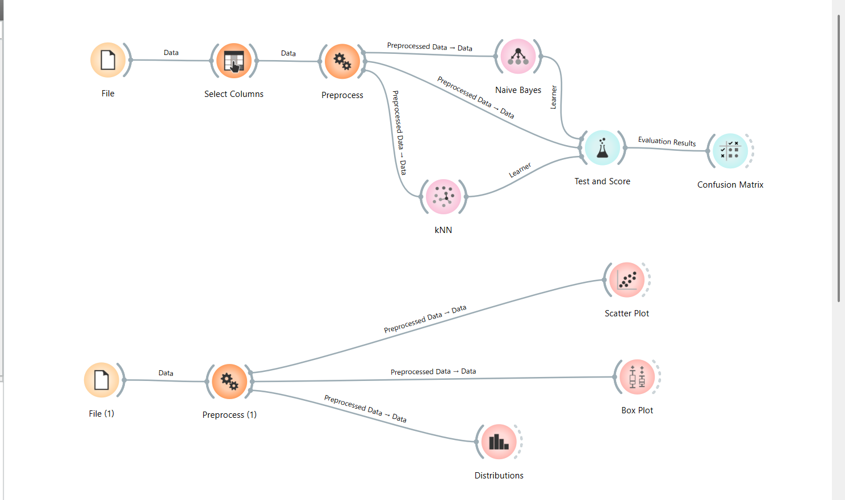
5.Orange Workflow

Slide 7
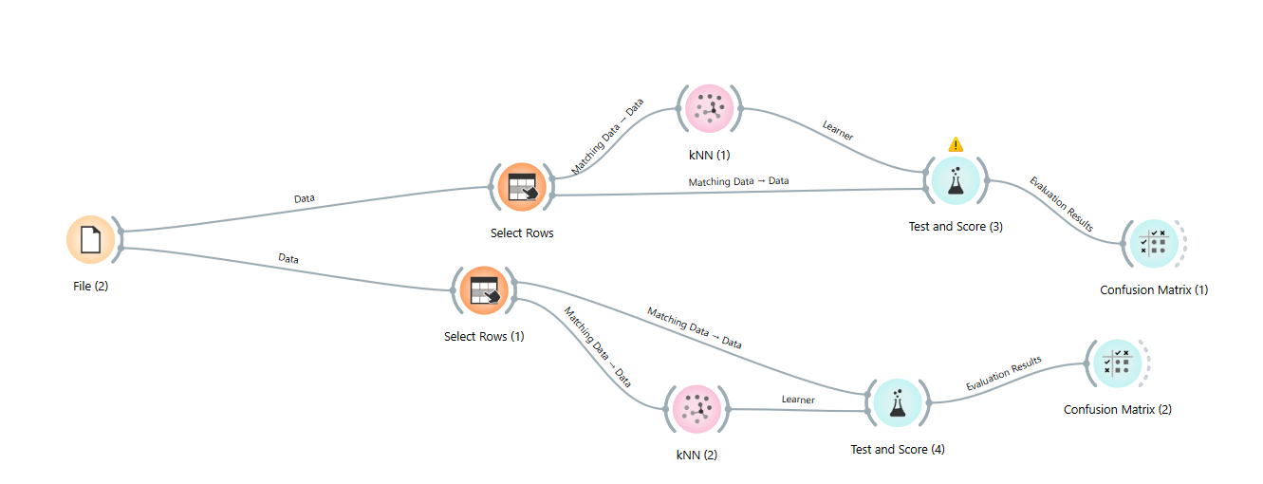
5.Orange Workflow

Slide 8
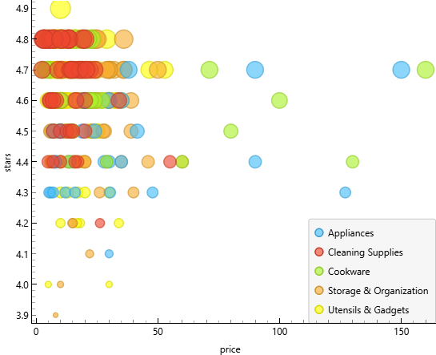
6.a.Data Visualisation
Scatter Plot — Price vs Star Rating
Most products have high ratings between approximately 4.3 and 4.8 stars, with substantial overlap across categories. Rating alone therefore provides limited separation between kitchenware categories, while price shows comparatively greater variation..

Slide 9
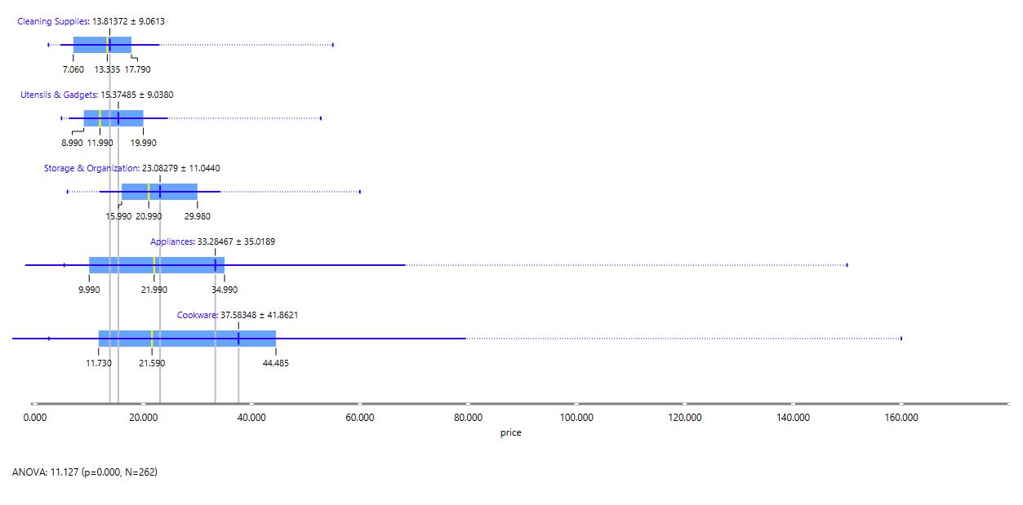
6.a.Data Visualisation
Box Plot — Price by Category
Price differs significantly across kitchenware categories (ANOVA, F = 11.127, p < 0.001). Appliances and Cookware show greater price variation, while Cleaning Supplies and Utensils & Gadgets are concentrated at lower price levels.

Slide 10
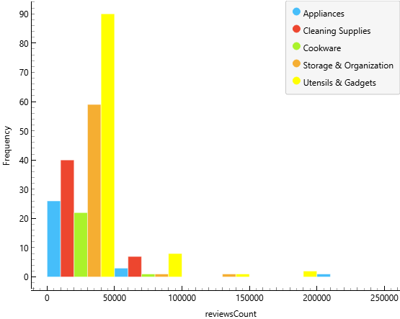
6.a.Data Visualisation
Distribution of Review Count by Category
The review-count distribution is strongly right-skewed. Most products have relatively low to moderate numbers of reviews, while a small number of products have extremely high review counts.
The majority of observations are concentrated below approximately 50,000 reviews, but there are a few products reaching well above 100,000 and even 200,000 reviews.
This means that popularity is not evenly distributed across the products.

Slide 11
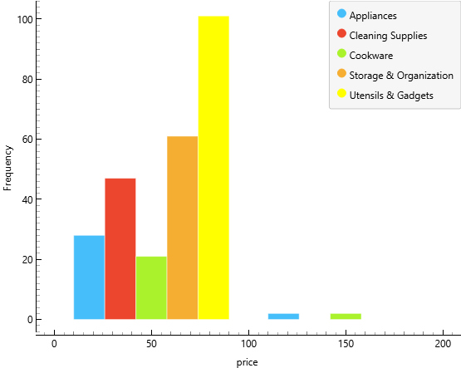
6.a.Data Visualisation
Distribution of Price by Category
The distribution indicates that most kitchenware products are concentrated in the lower price range, particularly below approximately $50. Utensils & Gadgets and Cleaning Supplies have a large number of products in the lower price range, while Appliances and Cookware also show some products at substantially higher prices.
There are a few high-price observations, particularly for Appliances and Cookware, extending well beyond the main concentration of products. This suggests that these categories have greater price variation compared with the lower-priced categories.

Slide 12
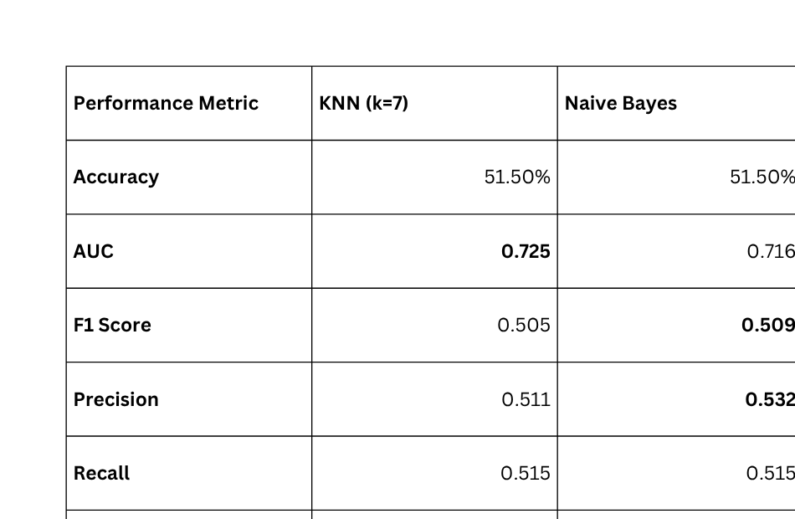
6.b.Comparison with Naive Bayes
Two classification models, KNN and Naive Bayes, were evaluated using 10-fold stratified cross-validation to predict the five kitchenware product categories. KNN was tested with k = 7 after preprocessing and normalization. Both models achieved the same overall accuracy, so additional performance measures were considered to select the more suitable model.
Test and score
KNN was selected because it achieved the higher AUC (0.725) and slightly higher MCC (0.332), while maintaining the same accuracy and recall as Naive Bayes.

Slide 13
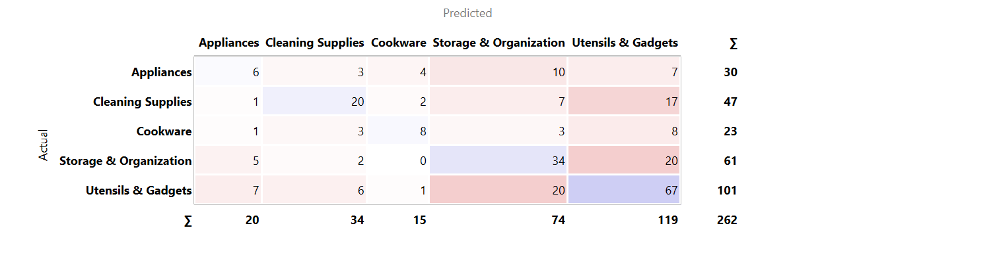
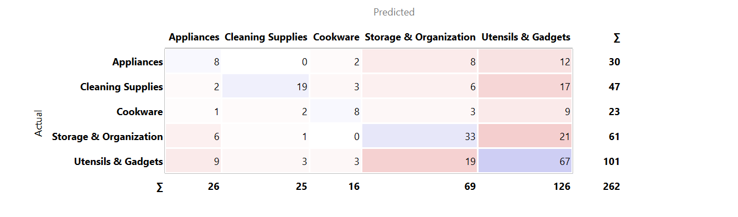
6.b.Comparison with Naive Bayes
Confusion Matrix
KNN
Naive Bayes

Slide 14
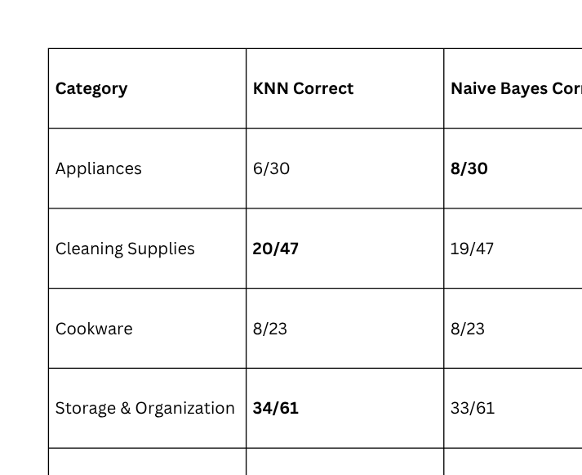
6.b.Comparison with Naive Bayes
Confusion Matrix
The confusion matrices show the number of products correctly and incorrectly classified across the five kitchenware categories. Values on the diagonal represent correct predictions, while off-diagonal values represent misclassifications.
Both models correctly classified 135 out of 262 products (51.5%). KNN performs slightly better for Cleaning Supplies and Storage & Organization, while Naive Bayes performs better for Appliances. Both models show similar difficulty in classifying Cookware, whereas Utensils & Gadgets has the highest number of correct predictions.
The substantial overlap between categories indicates that price, rating and review count alone provide limited separation among some kitchenware categories.

Slide 15
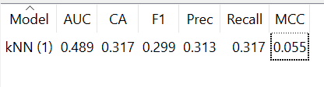

6.c.Comparative Analysis with another business model
To test whether brand identity plays a role in classification, the dataset was split into two separate business models: Branded products (the top 15 most frequent brands, kept individually) and Generic/"Other" products (156 brands that appeared only once, grouped under "Other"). The same kNN algorithm (k=7) was applied independently to each subset using identical preprocessing and features (price, stars, reviewsCount, Brand), evaluated using 10-fold stratified cross-validation.
Test and Score
Branded subset
Generic subset

Slide 16
6.c.Comparative Analysis with another business model
Both subsets perform substantially worse than the full-dataset model (51.5% accuracy, AUC 0.725, MCC 0.332), and the MCC values close to zero indicate both branded and generic sellers classify only marginally better than random guessing. This suggests that brand identity alone is not the primary driver of category separability — rather, the original model's predictive strength came from having sufficient combined data across price, rating, and review patterns. Splitting the market into "branded" and "generic" business models does not reveal meaningfully different classification behavior between the two; instead, it shows that both business types depend on the full market context to be classified accurately and that sample size reduction — not seller type — is the main factor behind the accuracy drop.

Slide 17
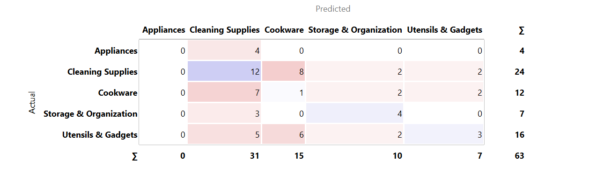
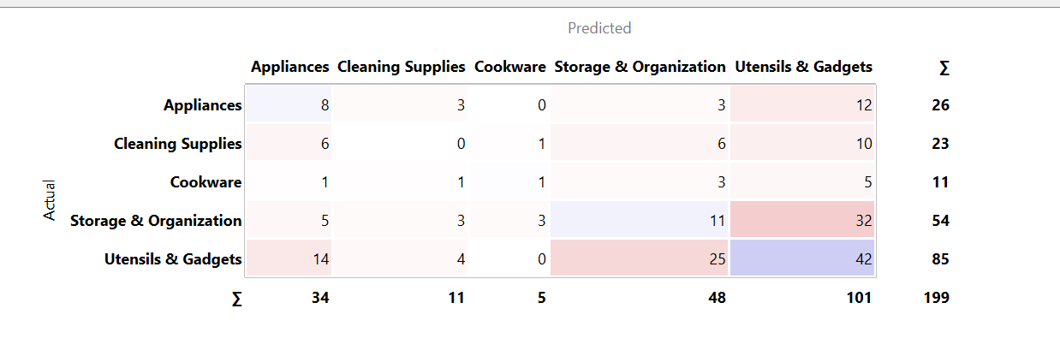
6.c.Comparative Analysis with another business model
Confusion Matrix
Generic subset
Branded subset

Slide 18
6.c.Comparative Analysis with another business model
The confusion matrices reveal where each subset breaks down. The Branded model (63 products) struggles heavily with Appliances (0/4 correct — completely missed) and Cookware (1/12), with most branded Cleaning Supplies and Storage & Organization items still frequently confused with each other. The Generic/Other model (199 products) shows the opposite pattern: it completely fails on Cleaning Supplies (0/23 correct, all misclassified — mostly into Utensils & Gadgets) and performs weakly on Appliances and Storage & Organization, while doing comparatively well on Utensils & Gadgets (42/85), likely because this category dominates the generic subset.
This confirms the earlier finding from the performance metrics: neither business model achieves reliable classification (both near-MCC-zero), but the nature of their errors differs. Branded products are too few and too spread across categories for the model to learn stable patterns, while generic products are heavily skewed toward Utensils & Gadgets, causing the model to over-predict that class at the expense of others. This reinforces that category separability depends on having a large, balanced dataset spanning the full market — segmenting by brand vs. generic seller type does not itself produce more distinguishable business patterns, and in fact fragments the data enough to weaken predictions further in both directions.

Slide 19
  Add text features: Use product titles and descriptions through TF-IDF or keyword extraction.
  Increase dataset size: Use more balanced data across categories.
  Add product attributes: Material, dimensions, seller and fulfilment type
  Explore advanced models: Apply neural networks or transformer-based methods using larger text/image datasets.
  Hierarchical classification: Predict the broad category first, followed by more specific sub-categories.
7.Future Scope

Slide 20
References
  Amazon Kitchen Best Sellers Dataset 2024

Slide 21
Thank
you

